Slide 1
Getting Started with Rust
Setting the scene
Hello World in Rust
Using Cargo

Slide 2
1. Setting the Scene
What is Rust?
Installing Rust
Verifying Rust installation

Slide 3
What is Rust?
Rust is a flexible and fast programming language
Combines power/speed with rigour/safety
You can use Rust to create all kinds of application
Low-level systems programming
High-level business applications
Toolsets (e.g., the Windows kernel is written in Rust)
Products (e.g. much of Firefox is written in Rust)
3

Slide 4
Installing Rust
To install Rust on Linux or macOS:
Run the following command in a Terminal window
Installs rustup, which then installs latest stable version of Rust
To install Rust on Windows:
See https://www.rust-lang.org/tools/install
You'll also need the C++ build tools for VS 2013 or later
curl --proto '=https' --tlsv1.2 https://sh.rustup.rs -sSf | sh
4

Slide 5
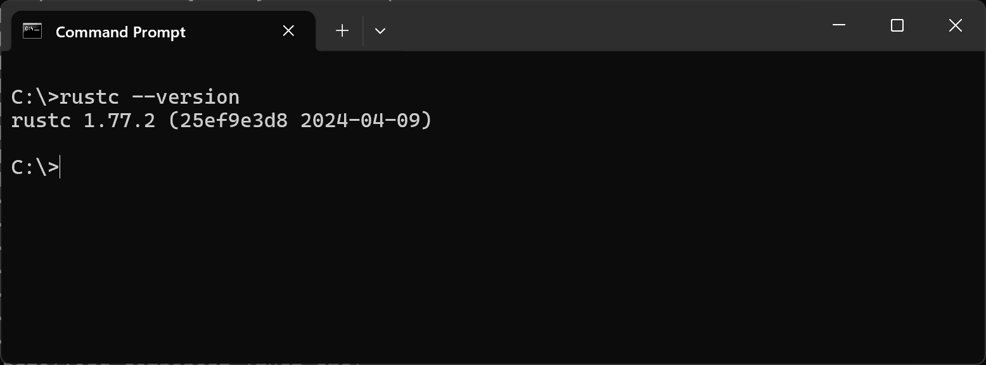
Verifying Rust Installation
To verify Rust installation:
Run the following command in a Terminal window
rustc --version
5

Slide 6
2. Hello World in Rust
Writing a simple application
Formatting the code
Building the application
Running the application
Aside: Using the Rust Playground

Slide 7
Writing a Simple Application
Here's the traditional 'hello world' application in Rust
main() is the entry-point function in a Rust executable
println! calls a macro (for info, search for macro_rules!)
Semicolons are required to separate statements
For detailed Rust documentation, see:
https://doc.rust-lang.org/std/index.html
fn main() {
println!("Hello, world!");
}
hello_world.rs
7

Slide 8
Formatting the Code
You can use the rustfmt tool to format your code
What does it do?
Replaces tabs with 4 spaces
Eliminates spurious whitespace
Arranges curly brackets according to Rust best practice
rustfmt hello_world.rs
8

Slide 9
Building the Application
To build the app, you can use the Rust compiler as follows:
What does it do?
Generates an executable (.exe file extension in Windows)
In Windows, also generates a .pdb file (contains debug info)
rustc hello_world.rs
9

Slide 10
Running the Application
To run the application on Linux or macOS:
To run the application on Windows:
./hello_world
.\hello_world.exe
10

Slide 11
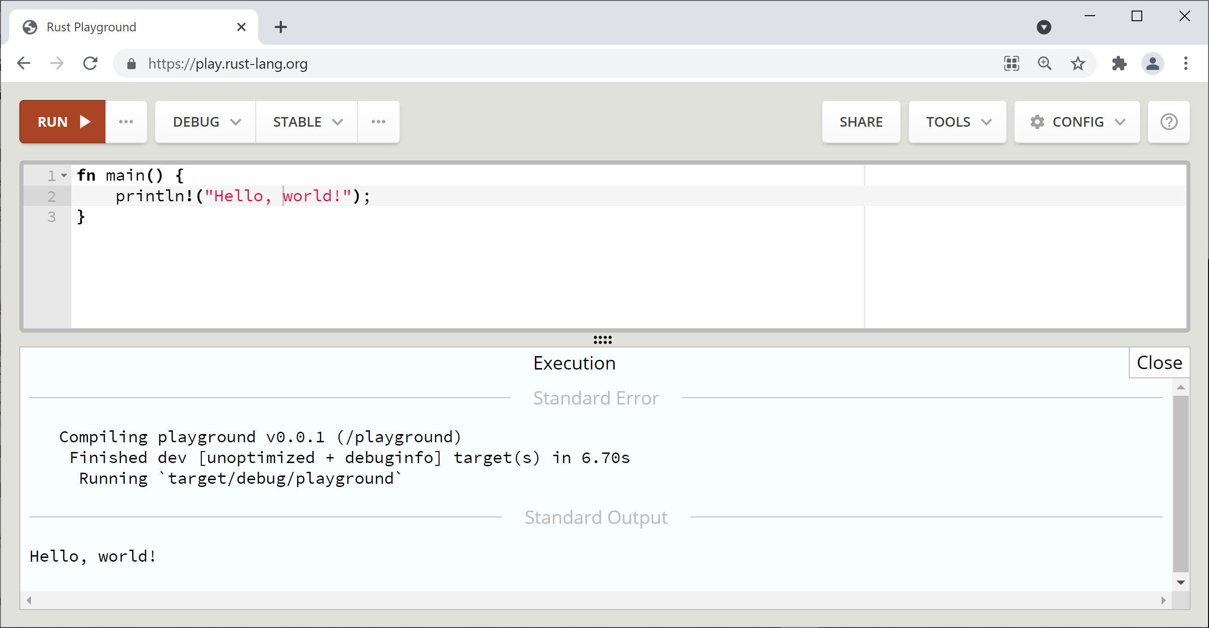
Aside: Using the Rust Playground
The Rust Playground is a handy online site you can use to practise your Rust syntax - go to https://play.rust-lang.org/
11

Slide 12
3. Using Cargo
What is Cargo?
Creating a new application using Cargo
Reviewing the .toml file
Reviewing the source code
Building/running in dev mode
Building/running in release mode
Additional Cargo techniques

Slide 13
What is Cargo?
Cargo is the Rust package manager and build system
Part of the standard Rust toolset
In practice, you'll always use Cargo to create, manage, and build your Rust applications
Consistency
Nudges you towards best practice
13

Slide 14
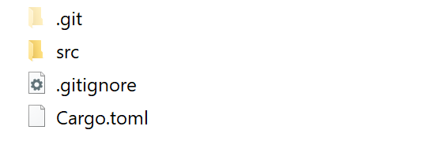
Creating a New Application using Cargo
You can use Cargo to create a new Rust application:
Creates a new directory for your application, containing:
cargo new hello_world_via_cargo
source code
packaging file
14

Slide 15
Reviewing the .toml file
The .toml file contains:
Metadata about your package (i.e. application)
Any additional dependencies your application needs
Fun fact:
TOML stands for Tom's Obvious Minimal Language
[package]
name = "hello_world_via_cargo"
version = "0.1.0"
edition = "2021"
[dependencies]
Cargo.toml
15

Slide 16
Reviewing the Source Code
Here's the source code generated by Cargo:
fn main() {
println!("Hello, world!");
}
src/main.rs
16

Slide 17
Building/Running in Dev Mode
To build the application in dev mode:
Fast build (unoptimized, contains debug info)
Creates app in .\target\debug\
To run the application (e.g. on Windows):
cargo build
.\target\debug\hello_world_via_cargo.exe
17

Slide 18
Building/Running in Release Mode
To build the application in release mode:
Slower build (optimized, no debug info)
Creates app in .\target\release\
To run the application (e.g. on Windows):
cargo build --release
.\target\release\hello_world_via_cargo.exe
18

Slide 19
Additional Cargo Techniques
You can build/run in one go:
Builds the app if it's changed, then runs it
If you just want a quick check to see if the code compiles:
Faster than a "build" because it doesn't generate an executable
cargo run
or
cargo run --release
cargo check
19

Slide 20
Summary
Setting the scene
Hello World in Rust
Using Cargo

